Slide 1
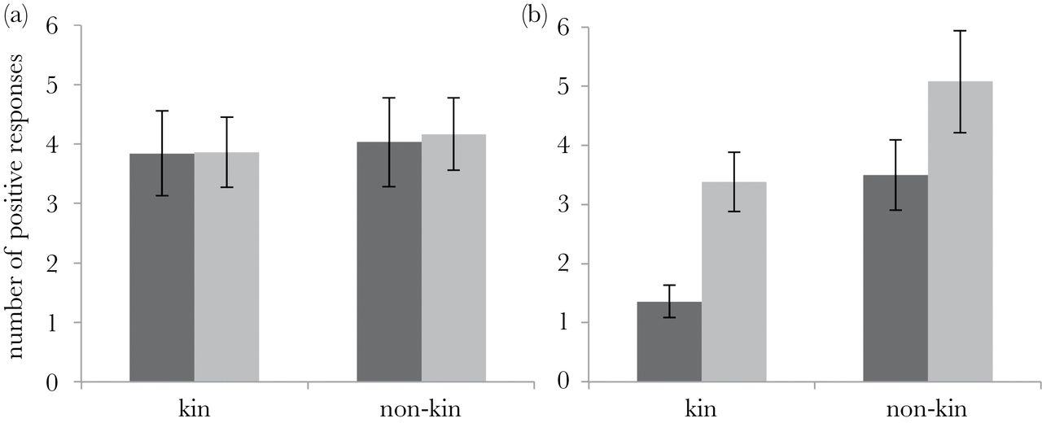

Figure 1 Numbers of positive responses for (a) virgin and (b) nonvirgin females directed toward males that were ...
Notes:
Figure 1 Numbers of positive responses for (a) virgin and (b) nonvirgin females directed toward males that were brothers or nonkin and were familiar (dark gray) or unfamiliar (light gray). Error bars denote standard errors.
Unless provided in the caption above, the following copyright applies to the content of this slide: © The Author 2015. Published by Oxford University Press on behalf of the International Society for Behavioral Ecology. All rights reserved. For permissions, please e-mail: journals.permissions@oup.com

